Slide 1

SMART INDIA HACKATHON 2026
TITLE PAGE
Problem Statement ID – SIH26215
Problem Statement Title- Students innovation
Theme- MedTech/ BioTech/ HealthTech
PS Category- Hardware
Team ID-
Team Name – Team Echobraille

Slide 2
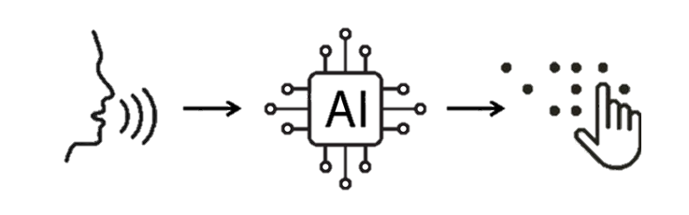
EchoBraille: An Intelligent AI-Based
Voice-to-Braille Assistive Device
Team
Echobraille
PROBLEM
SOLUTION
AI mainly communicates through text or voice, inaccessible to deafblind users.
Deafblind users cannot easily read AI text or hear AI responses.
1.5B+ people have hearing loss and 2.2B+ have vision impairment worldwide.
Existing smartphones, chatbots and voice assistants depend heavily on sight or hearing.
Electronic Braille systems can be expensive and complex, requiring specialized hardware/software.
There is a need for a simple, portable and affordable system that converts AI responses into physical Braille.
Converts voice input into text using speech recognition.
Uses an AI chatbot to understand queries and generate meaningful responses.
Converts AI-generated text into standard 6-dot Braille patterns.
Sends Braille data wirelessly to an ESP32 controller.
Uses six servo-driven tactile pins to physically display each Braille character.
Provides a portable, affordable AI-to-Braille system for independent access through touch.
“Bridging AI and the deafblind community through affordable, portable, real-time tactile communication.”

Slide 3
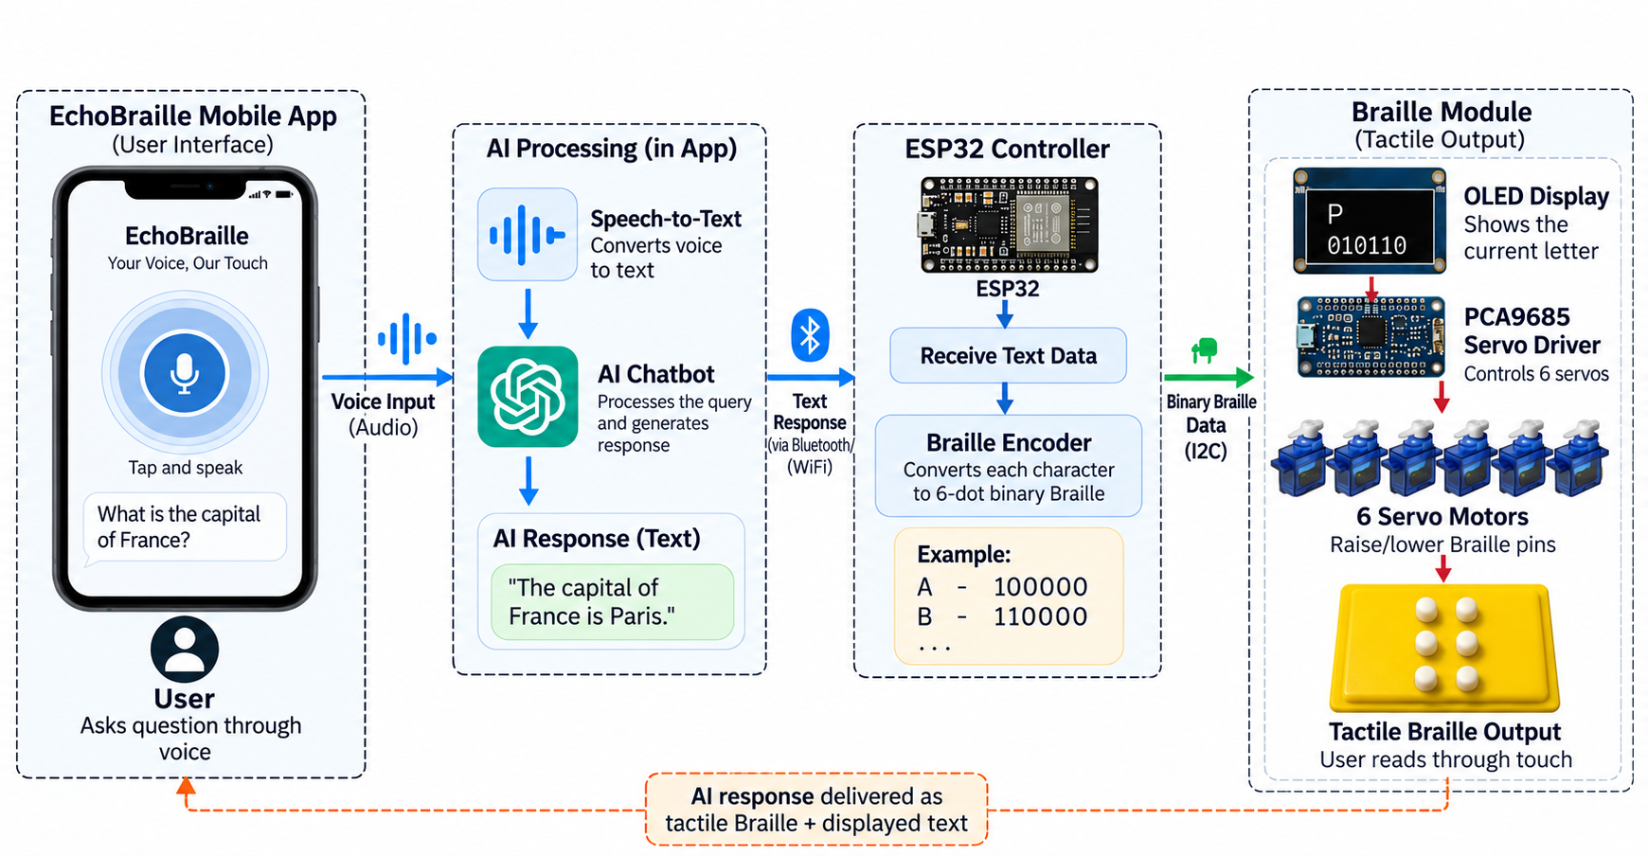
TECHNICAL APPROACH
Team
Echobraille

Slide 4
FEASIBILITY AND VIABILITY
Team
Echobraille
Aspect | Technical | Analysis of the Feasibility of the Idea | Potential Challenges & Risks | Strategies for Overcoming These Challenges
Feasibility | ESP32 for wireless communication; PCA9685 servo driver; 6 servo motors for 6-dot Braille; OLED display for text feedback; mobile application with speech-to-text and AI chatbot; Braille encoder for text-to-Braille conversion. | Uses readily available, cost-effective components. The prototype can operate with wireless communication between the app and ESP32. The braille module is comparatively cheap (≈ ₹1500 per module) than typical commercial Braille displays. | Servo positioning accuracy; wireless connectivity and response latency; power management for portable use; mechanical durability of tactile pins. | Precise servo calibration; optimized Bluetooth/Wi-Fi communication; efficient power design; robust mechanical enclosure and repeated prototype testing.
Risks and Challenges | Speech-to-text (voice input); AI response generation; 6-dot Braille conversion; servo-based tactile output; OLED display for corresponding letter. | Each stage is technically achievable with existing technologies. However, errors in any stage can affect the final Braille output. | Speech recognition errors (noise, accents); incorrect or irrelevant AI responses; Braille encoding errors; inconsistent servo movement; hardware failure. | Use reliable speech-to-text APIs; response filtering and verification; standard Braille mapping; servo calibration and testing; regular hardware checks and error handling in software.
Operational Strategies to overcome | AI chatbot (cloud/app); Braille encoder (ESP32); PCA9685 servo driver; tactile Braille module with OLED display; wireless communication. | Separation of AI processing (app) and tactile hardware (ESP32) makes the system easier to develop, test and upgrade. The low-cost braille module makes it more accessible and scalable for wider use. | Dependence on internet/AI services; mechanical wear or misalignment of servo pins; power constraints for portable use; user adaptation. | Modular architecture; offline/basic fallback functions where possible; use durable components and periodic calibration; efficient battery management; user testing and feedback for improvements.

Slide 5
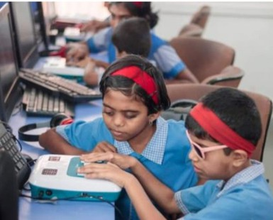
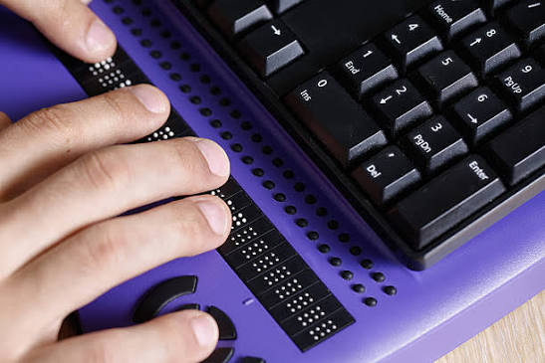
IMPACT AND BENEFITS
Team
Echobraille
A NEW DIMENSSION OF ACCESS
FUTURE SCOPE
AI Accessibility – Enables deafblind users to access AI-generated information through touch.
Greater Independence – Reduces dependence on others for accessing digital information.
Affordable Assistive Technology – Uses a low-cost, modular hardware approach compared with conventional electronic Braille displays.
Educational Support – Can provide accessible explanations, learning content and information through tactile Braille.
Portable & Practical – Combines a smartphone, ESP32 and compact Braille module into a portable system.
Inclusive AI – Extends conversational AI beyond visual and audio interfaces to the tactile domain.
Multi-Character Display: Upgrade from single-character output to a multi-character refreshable Braille display.
Faster Actuation: Use electromagnetic or inductive actuation for faster and more compact tactile output.
Reduced Reading Time: Display multiple characters simultaneously for faster, more natural reading.
Advanced Features: Add multilingual Braille support and enhanced AI capabilities.
“Our motto is simple: Making AI accessible, one touch at a time. We believe technology should go beyond sight and sound, creating a world where everyone can experience the power of AI.”

Slide 6
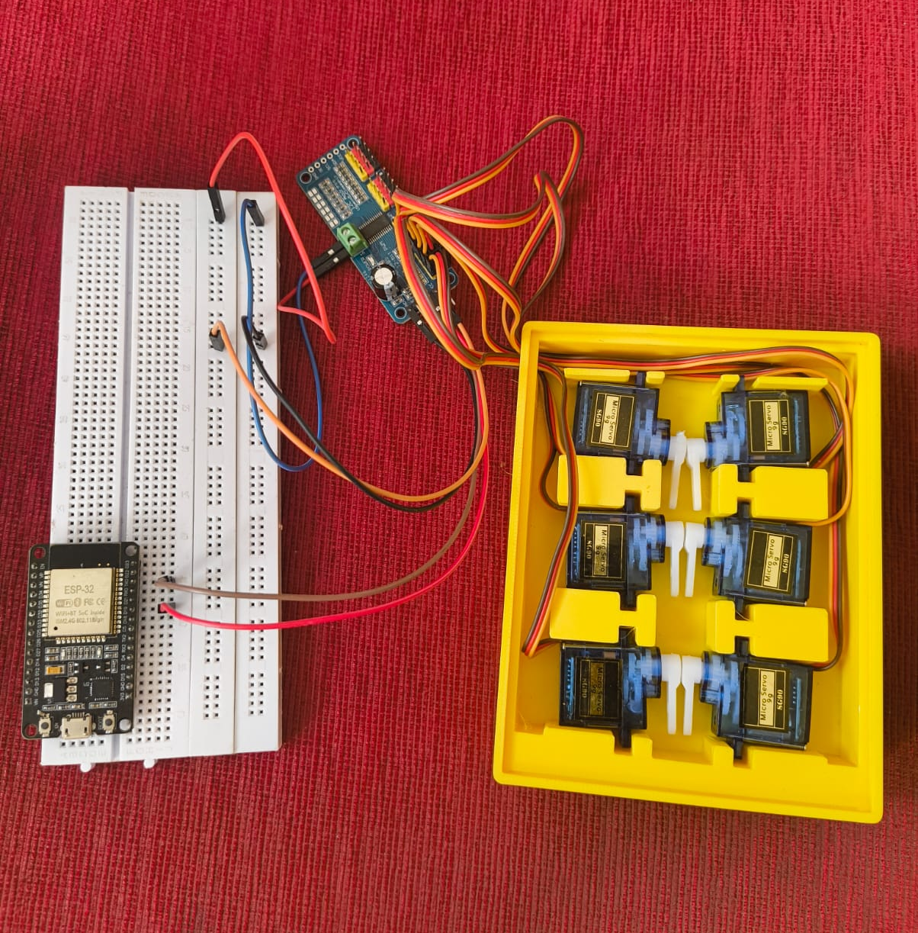
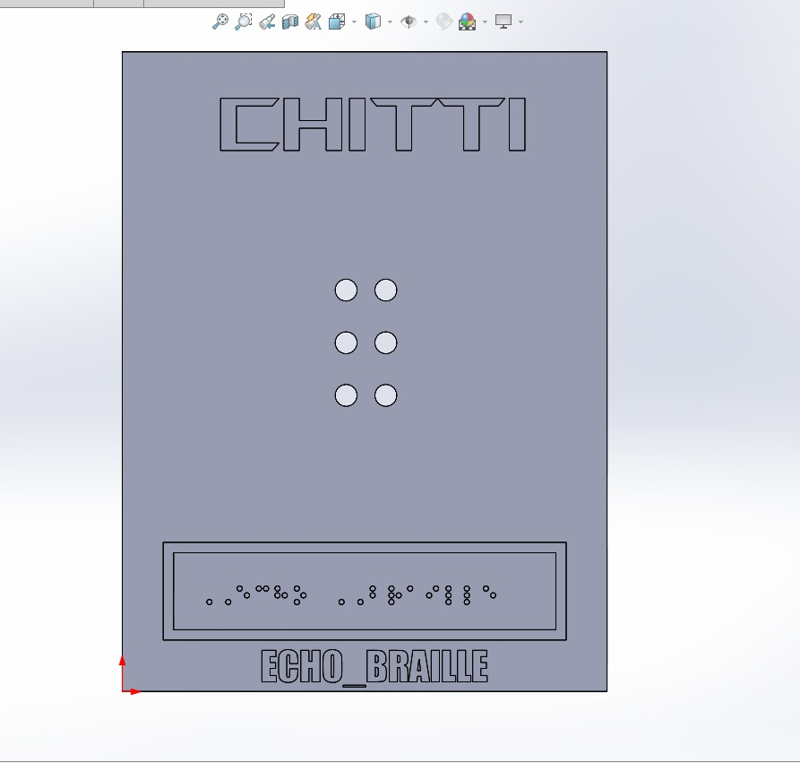
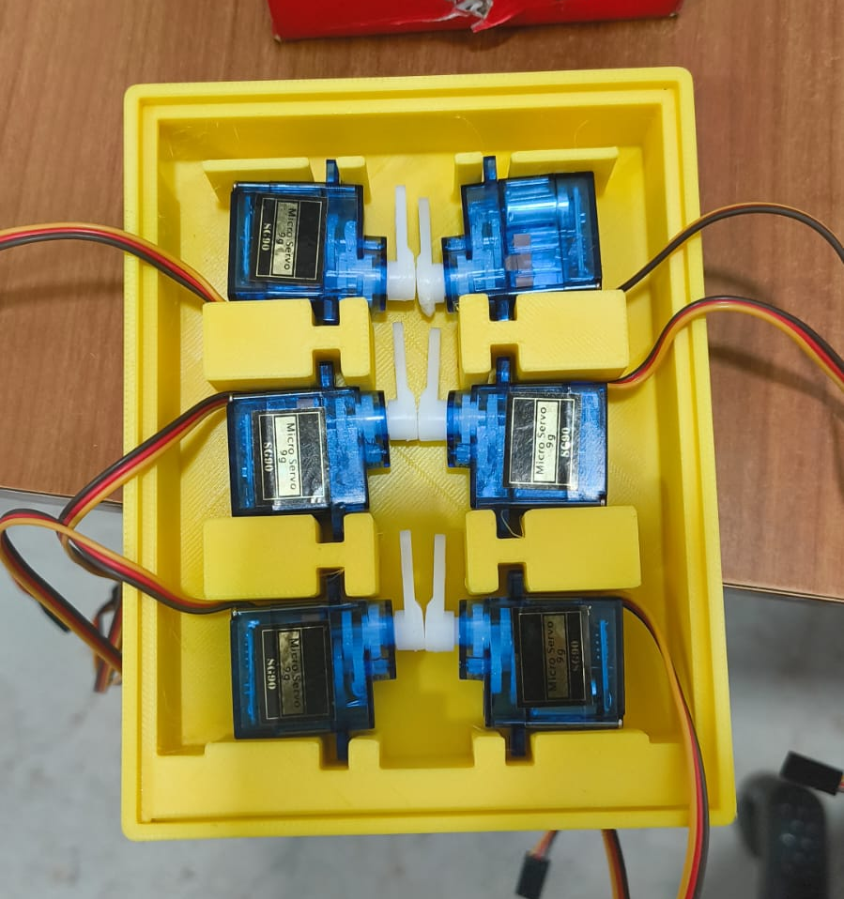
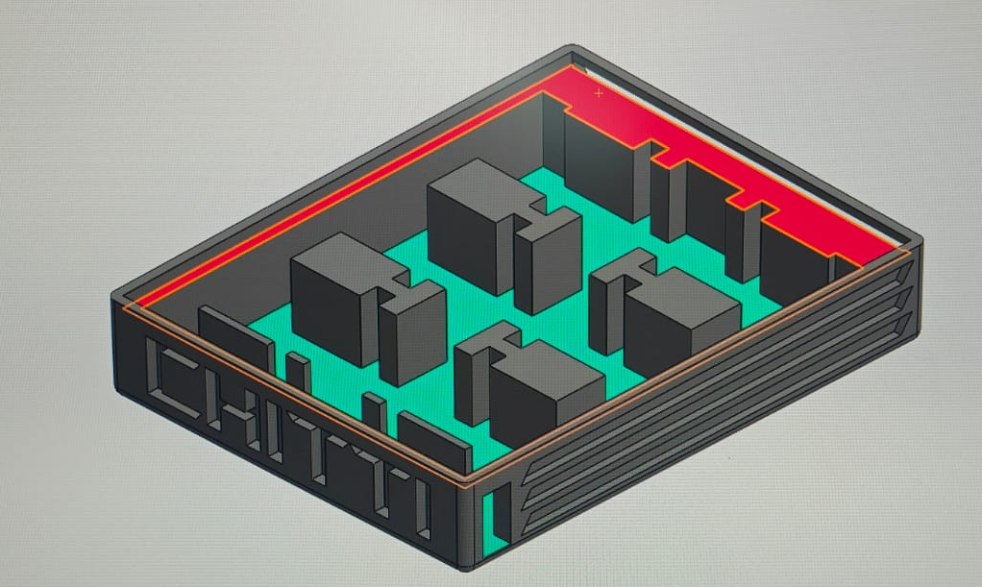
RESEARCH AND REFERENCES
Team
Echobraille
PROTOTYPE IMAGES:
LINKS AND REPOSITORY
Blindness and Vision Impairment, 2026:
https://www.govinfo.gov/content/pkg/GOVPUB-LC19-PURL-gpo38772/pdf/GOVPUB-LC19-PURL-gpo38772.pdf
Tactile display as a Braille display for the visually disabled:
https://ieeexplore.ieee.org/document/1389689
Electromechanical Refreshable Braille Module:
https://youtu.be/BXi1tG78AW4?si=8tUXQTDPtk81DVBa
GitHub repository containing project files prototype working video:
https://github.com/dhamodharan-13/EchoBraille

